Slide 1
Modern app development
Norman Vicente

Slide 2

Who I am?
Consultant at Xumak
Android Software Developer for Wunderman Thompson
Master’s Degree Student in Data Science
Past conferences: TedxGuatemala, Google I/O Extended Guatemala, Balanya University Club
Caption

Slide 3
2021 Android Development roadmap

Slide 4
Mockup - UI

Slide 5
Programming Languages
Native: Kotlin, Java
Hybrid: Dart (Flutter), Javascript (React Native)

Slide 6
IDE - Text Editor

Slide 7
Here

Slide 8
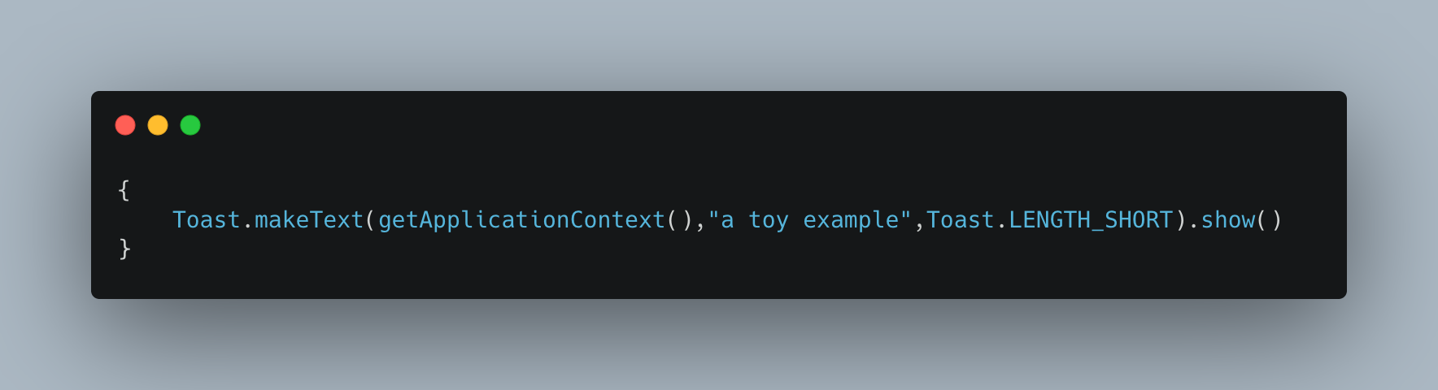

“toy example”
Java Example
Kotlin Example

Slide 10
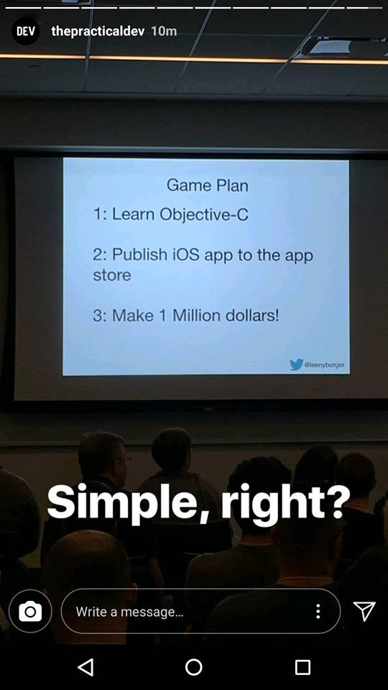

Slide 11
Android app architecture
Mockup - UI
Programming language
Android pattern
Android documentation

Slide 12
Android app architecture
Mockup - UI
Programming language
Android pattern <—
Android documentation

Slide 13
Common Architectural Patterns
MVVM
MVP
MVP
MVI

Slide 14
https://developer.android.com/jetpack/guide

Slide 15
Common libraries for modern android app
Image Handler
Glide, Picasso, Coli
Networking
Retrofit, OkHttp
Dependency injection
Dagger, Hilt
https://github.com/wasabeef/awesome-android-libraries

Slide 16
Android documentation
Kdoc
JavaDoc

Slide 17
Here

Slide 18

You Here

Slide 19
Outside of android development

Slide 20
Now Here

Slide 21
Data
Firebase
MySQL
SQL Server
mongoDB

Slide 22
Here

Slide 23
Getting data
Firebase
REST APIs

Slide 24
:)

Slide 25
Some code for you
https://github.com/normanaspx/WTAChallenge

Slide 26
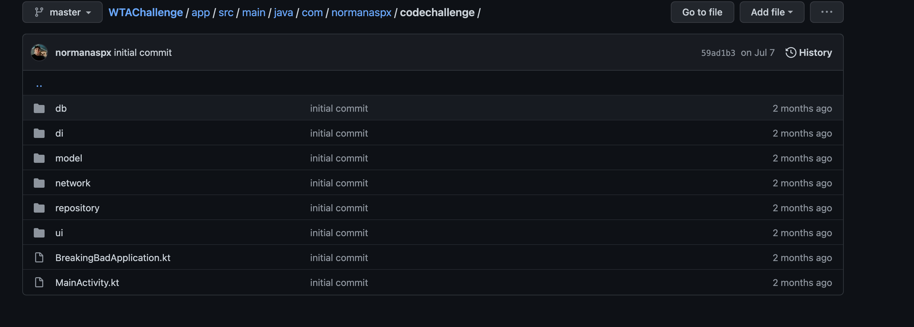
Some code for you
https://github.com/normanaspx/WTAChallenge

Slide 27
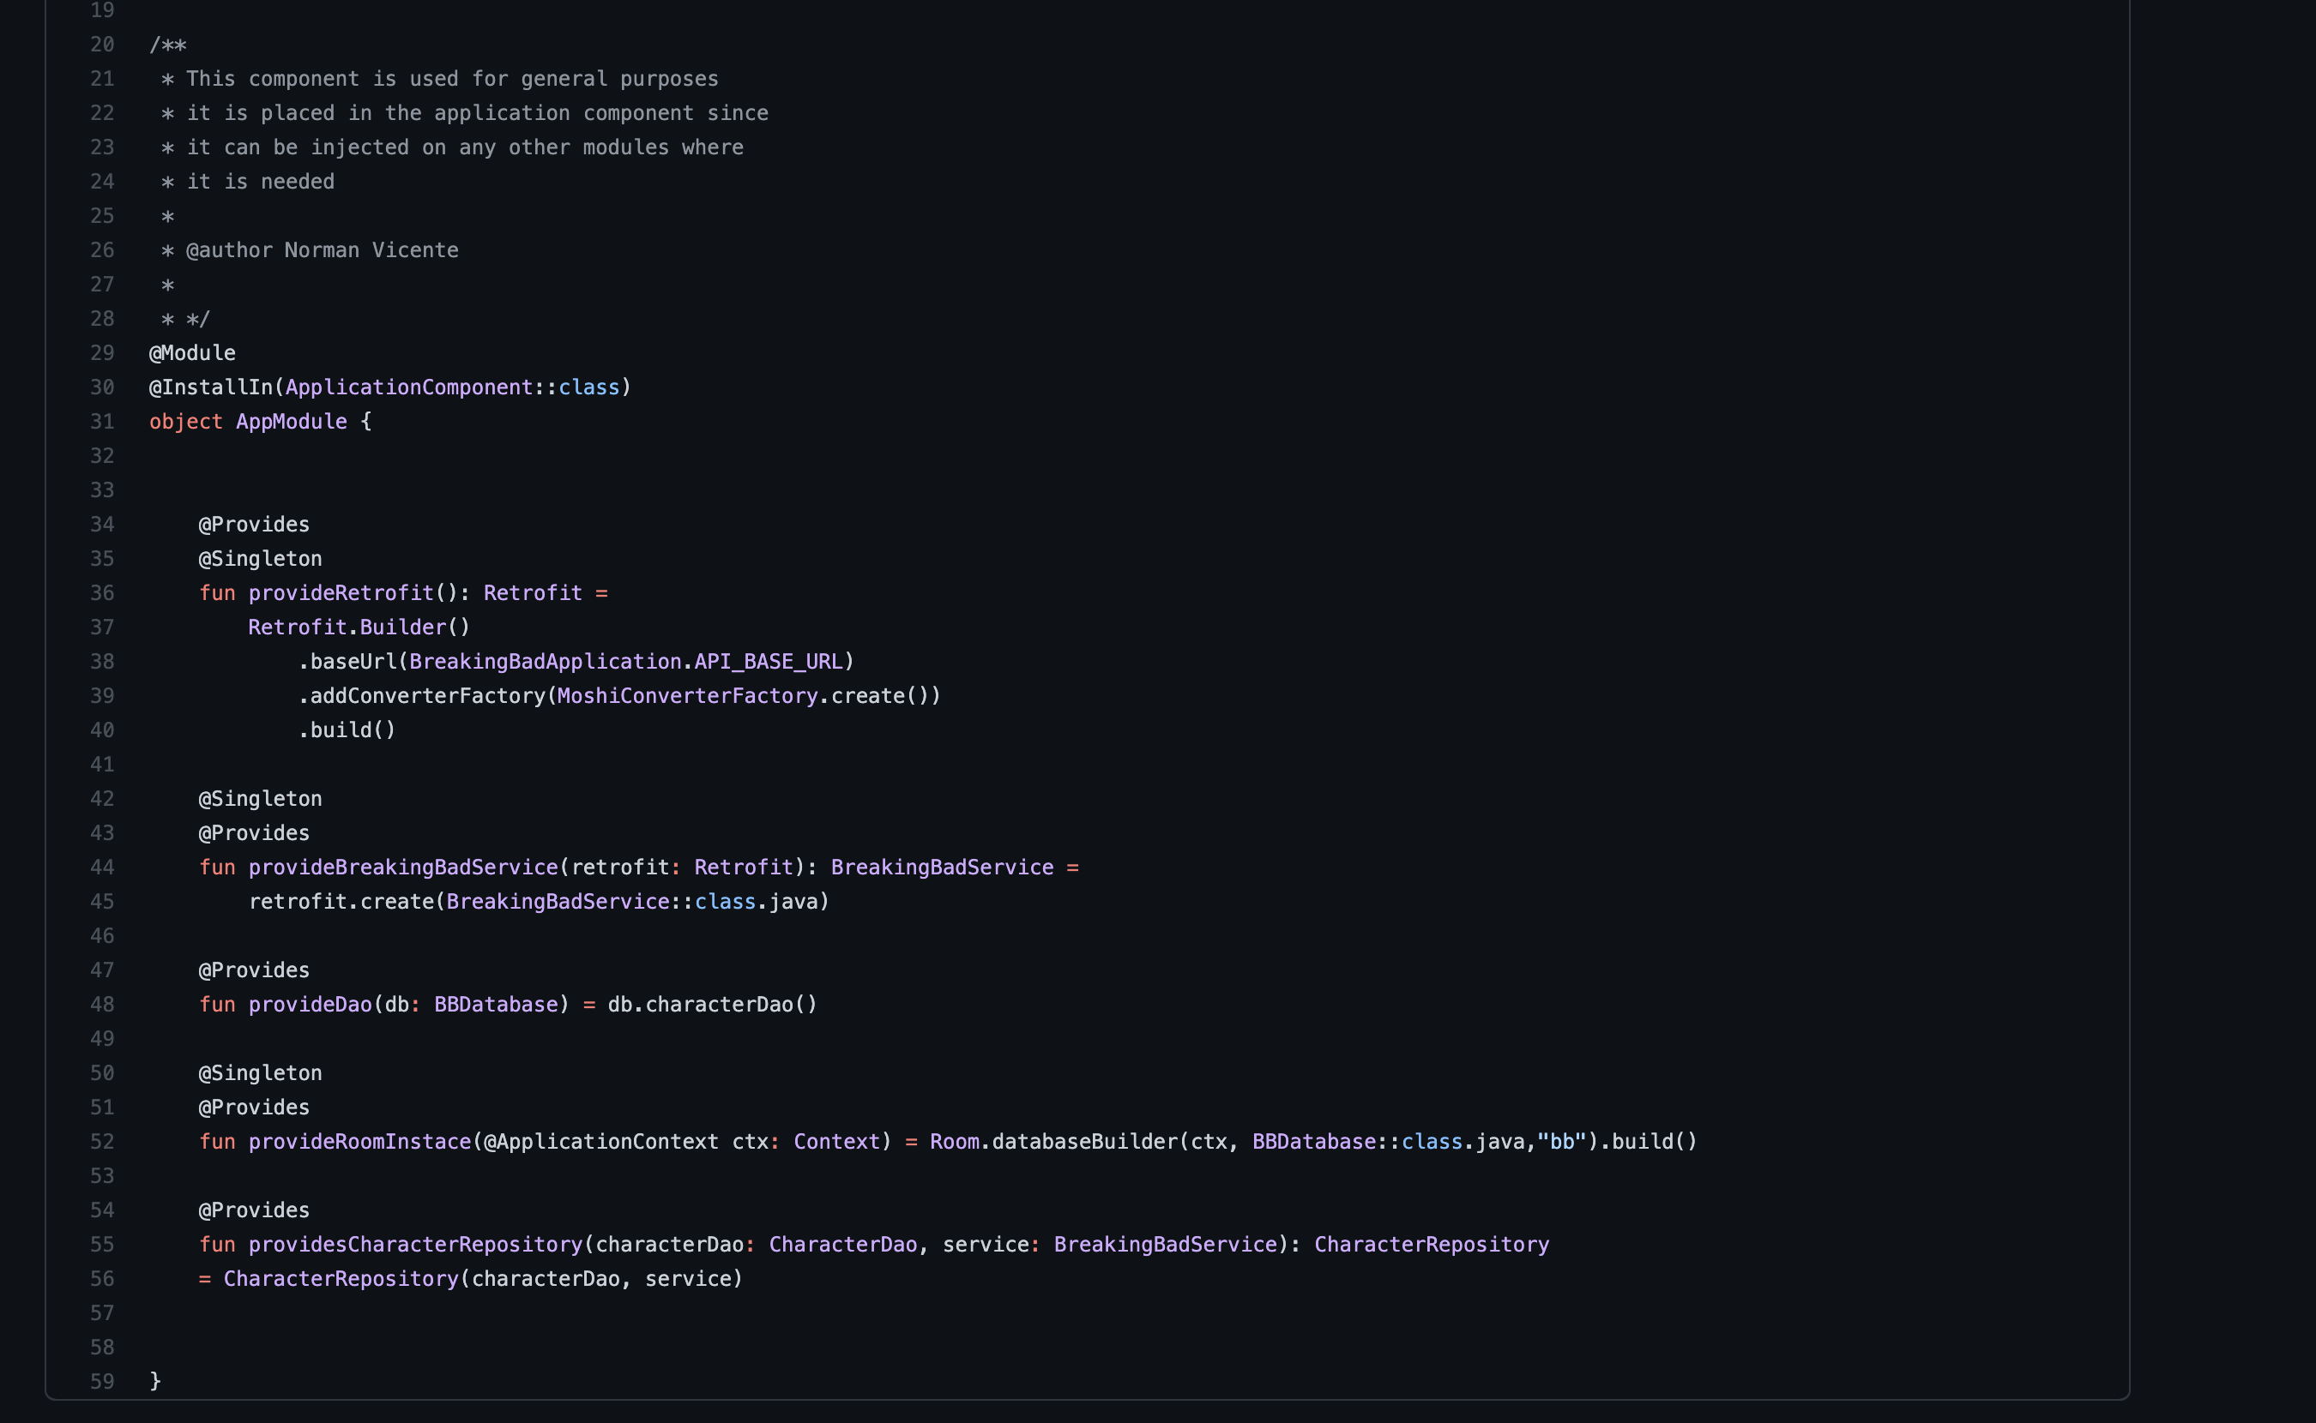
Some code for you
https://github.com/normanaspx/WTAChallenge

Slide 28
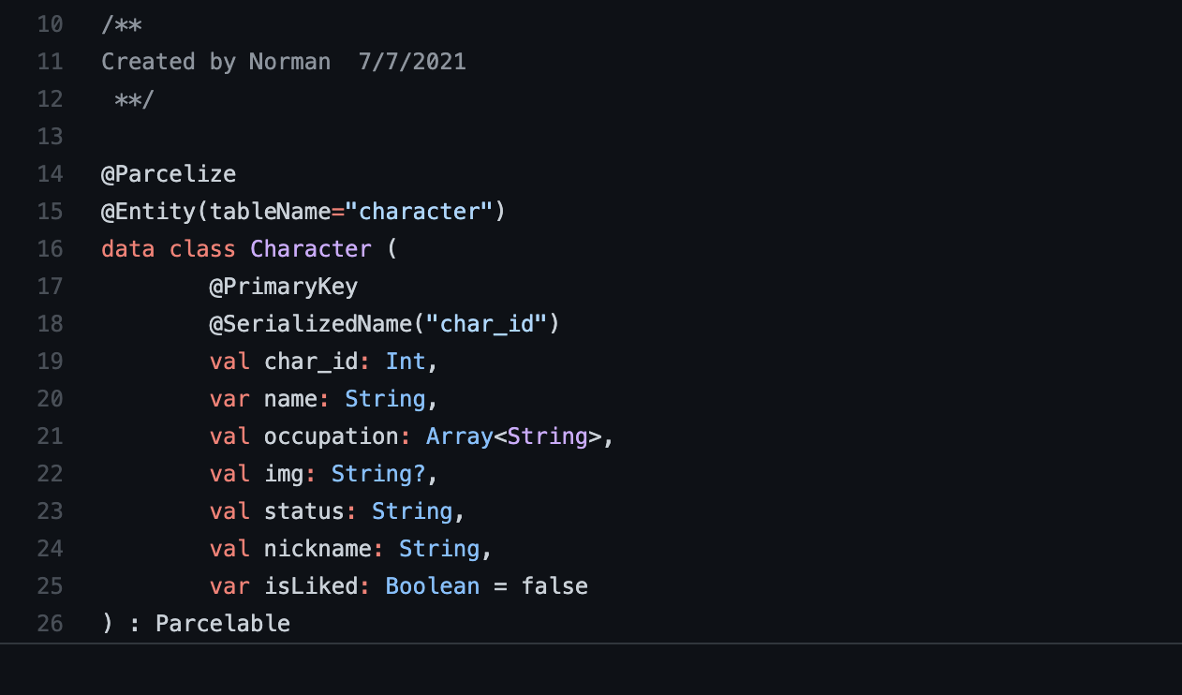
Some code for you
https://github.com/normanaspx/WTAChallenge

Slide 29
Some code for you
https://github.com/normanaspx/WTAChallenge

Slide 30
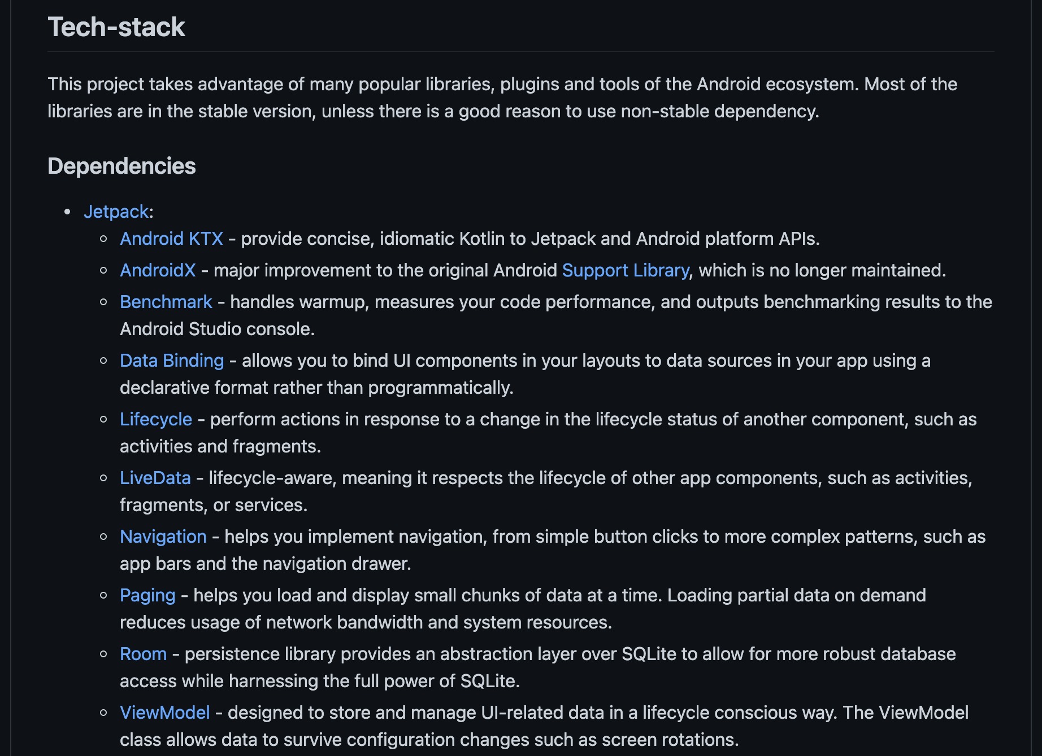
Some code for you
https://github.com/vmadalin/android-modular-architecture

Slide 31
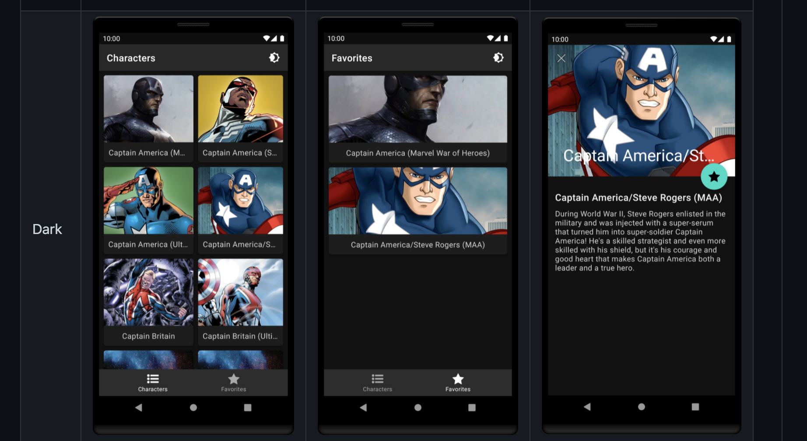
Some code for you
https://github.com/vmadalin/android-modular-architecture

Slide 32
Challenge for you
https://github.com/public-apis/public-apis
Clone repo
Update the code to be able to consume the API of your choice
I chose: https://breakingbadapi.com/
I chose: https://unsplash.com/developers

Slide 33
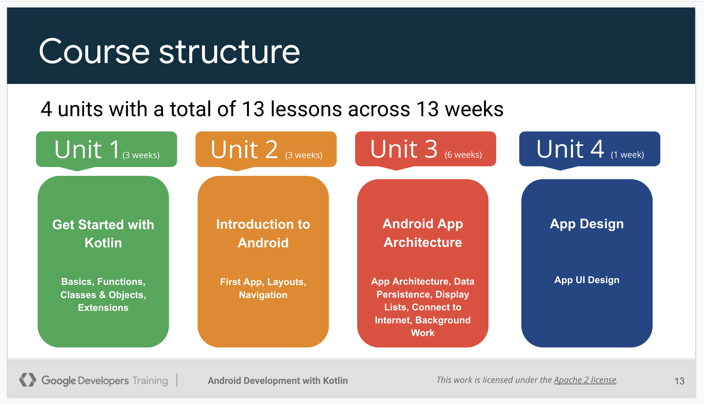
Official resources
https://developer.android.com/kotlin?hl=es-419

Slide 34
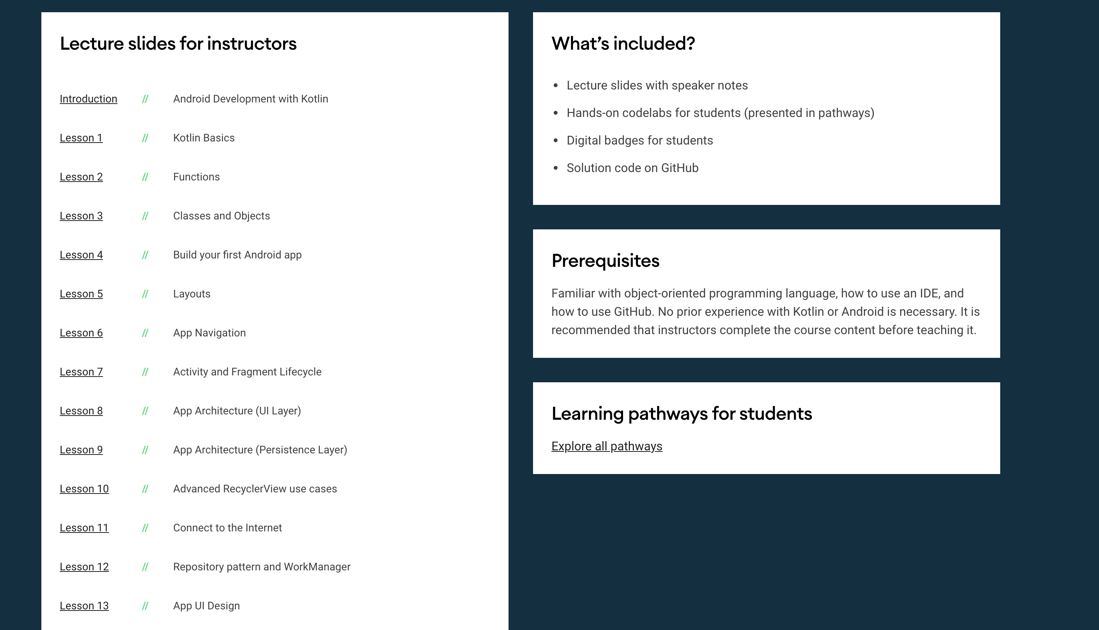
Official resources
https://developer.android.com/teach

Slide 35
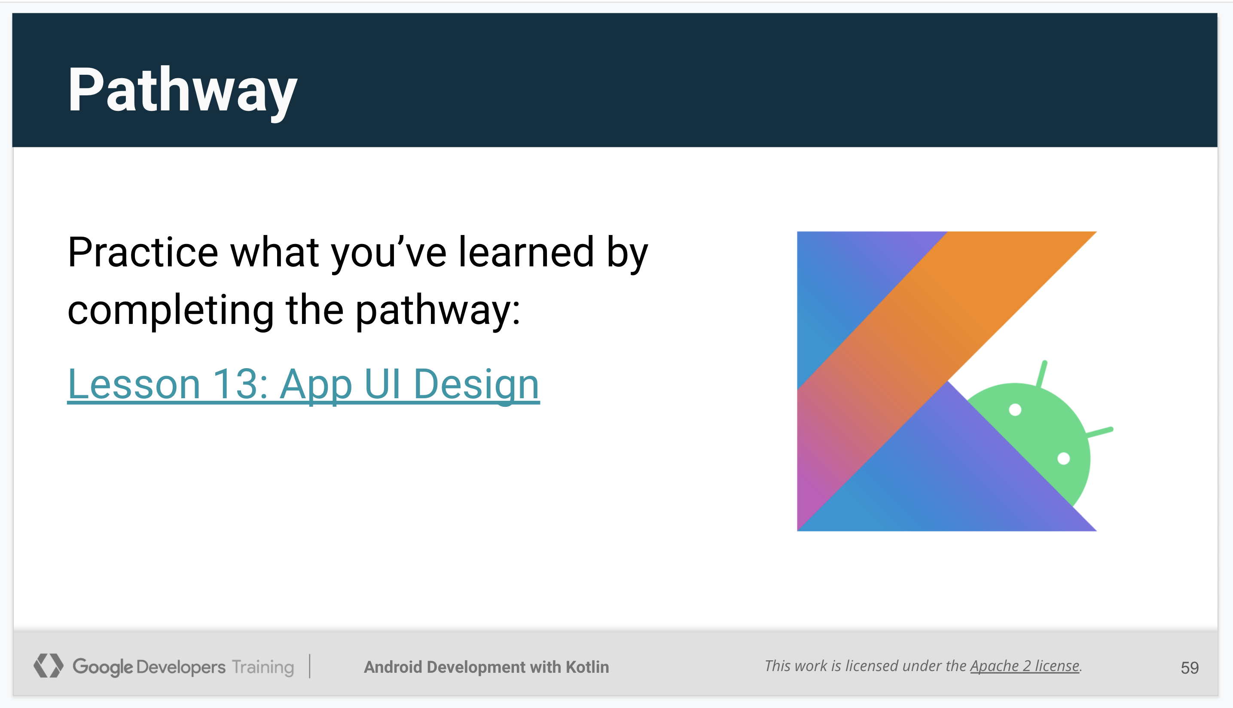
Official resources
https://developer.android.com/courses/pathways/android-development-with-kotlin-13

Slide 36
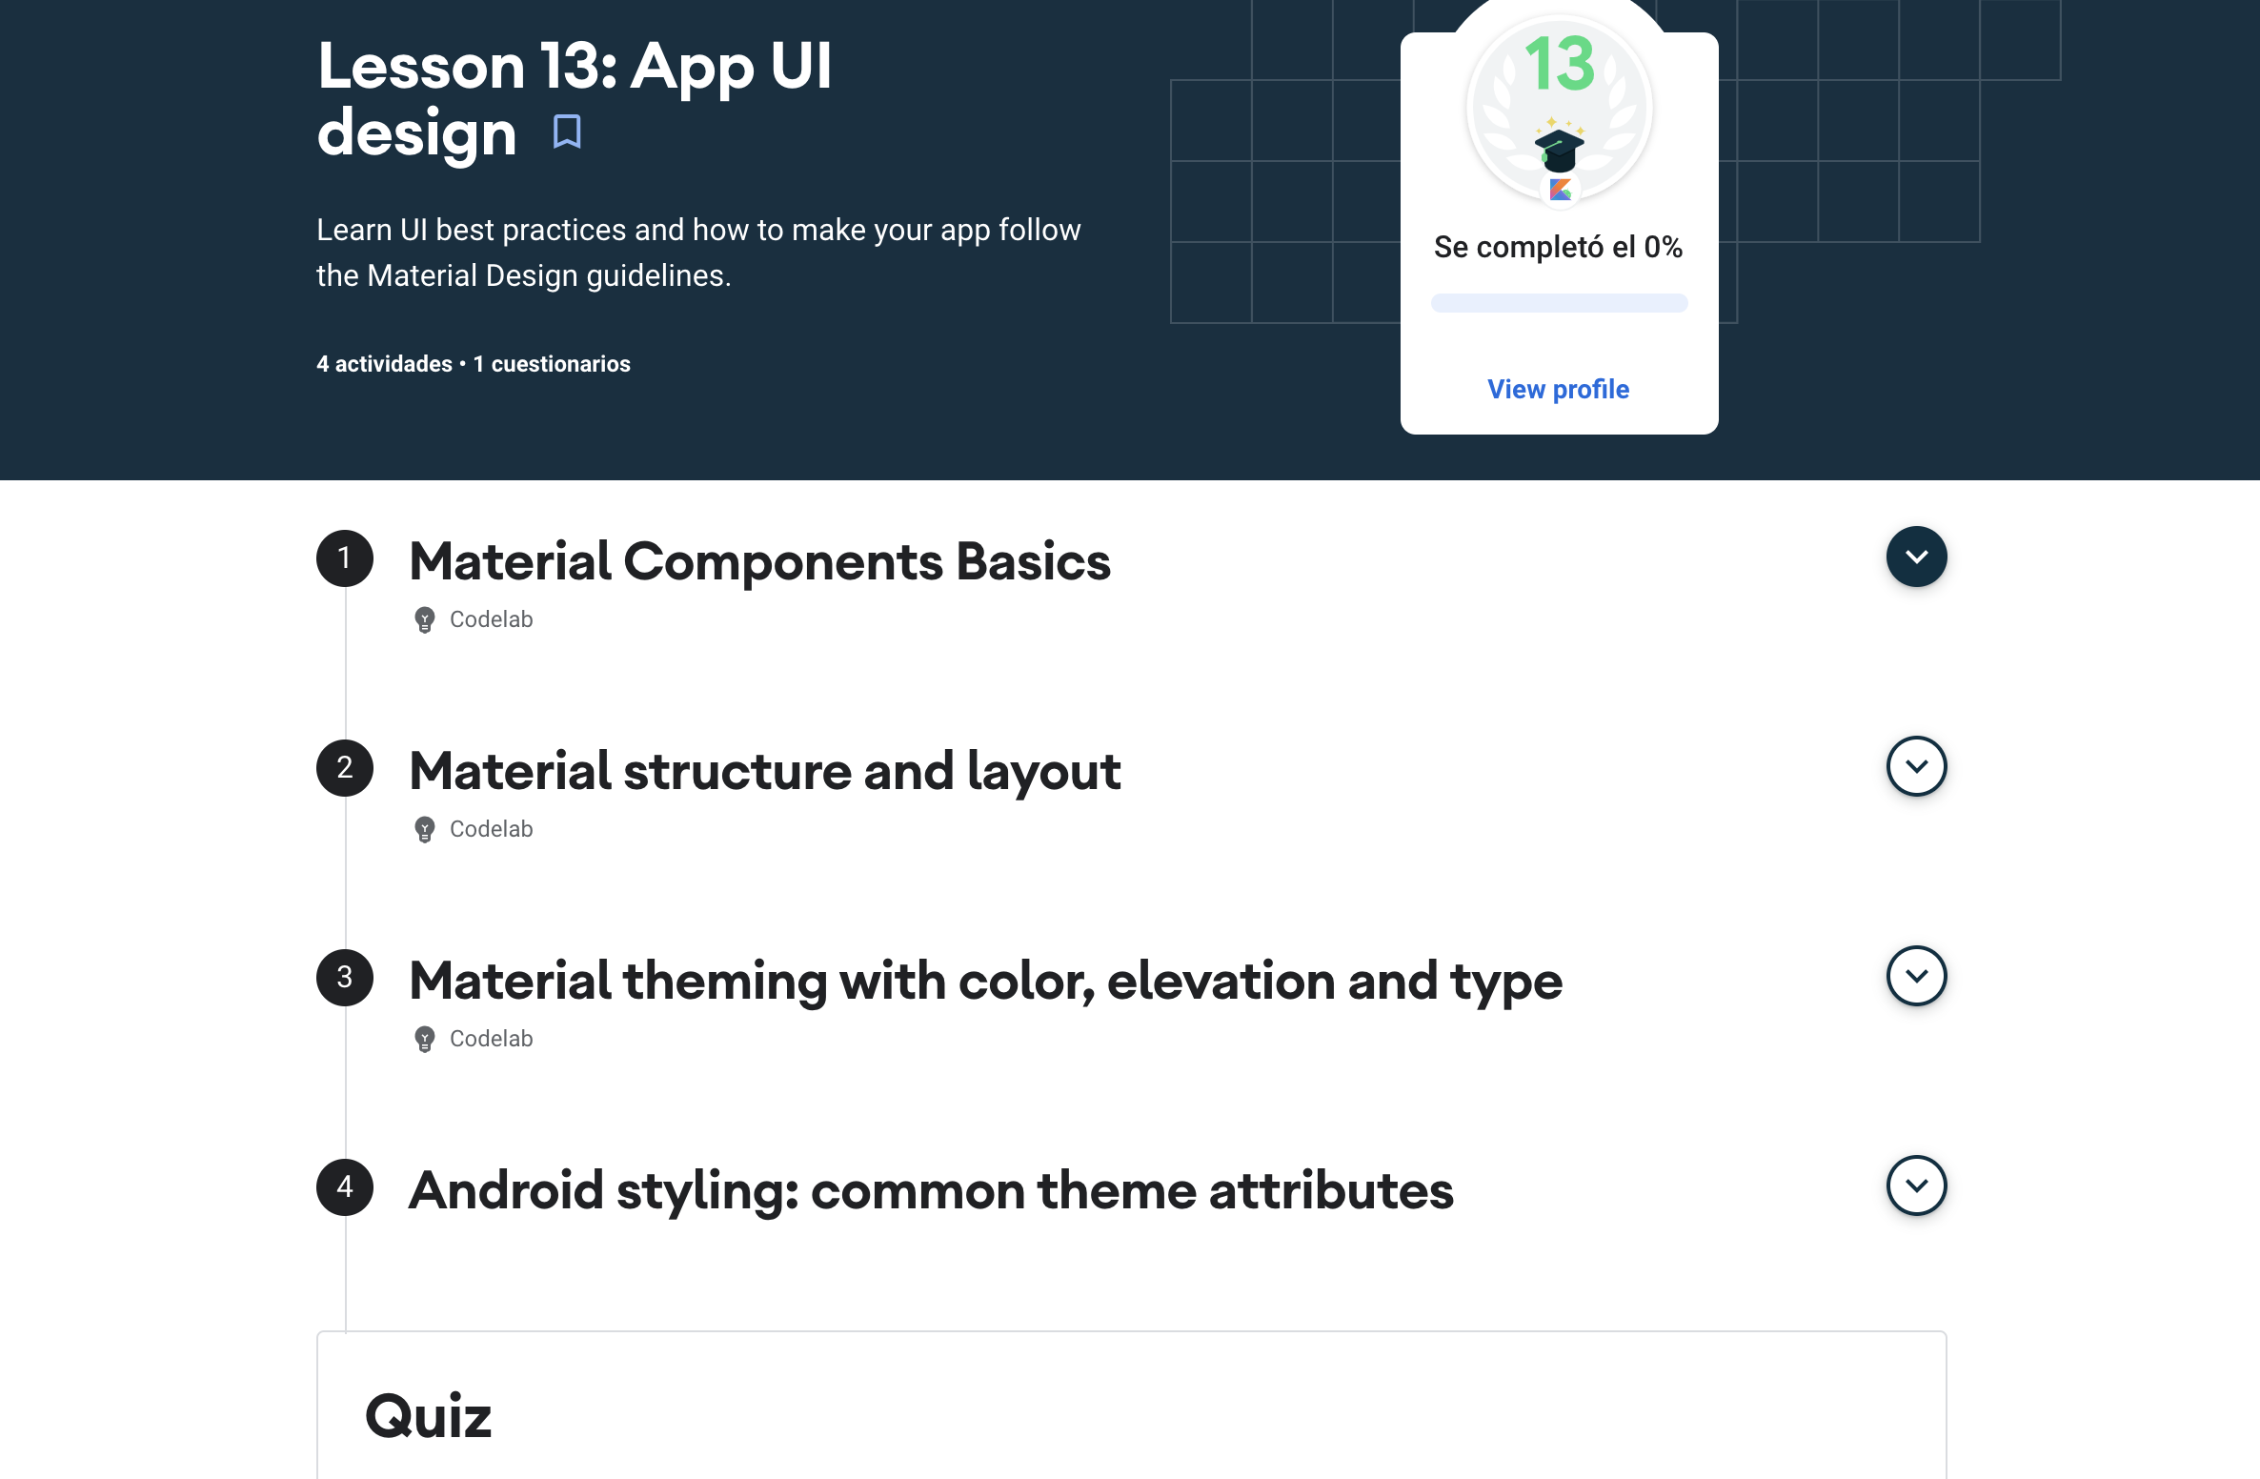
Official resources
https://developer.android.com/courses/pathways/android-development-with-kotlin-13

Slide 37
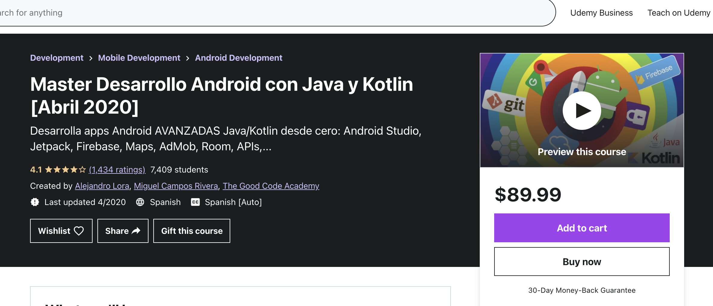
Recommended resources
https://www.udemy.com/course/programacion-android-avanzado-de-principiante-a-experto/

Slide 38
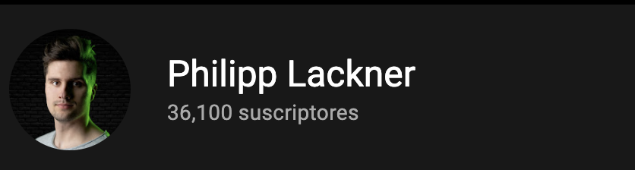


Recommended resources
https://www.youtube.com/c/PhilippLackner/featured
https://www.youtube.com/c/CodinginFlow/featured
https://www.youtube.com/c/SociedadAndroide/featured

Slide 39
“Make a 1million dollars”
–Nobody

Slide 40
Q&A

Slide 41
https://github.com/normanaspx/ieee-conference

Slide 42
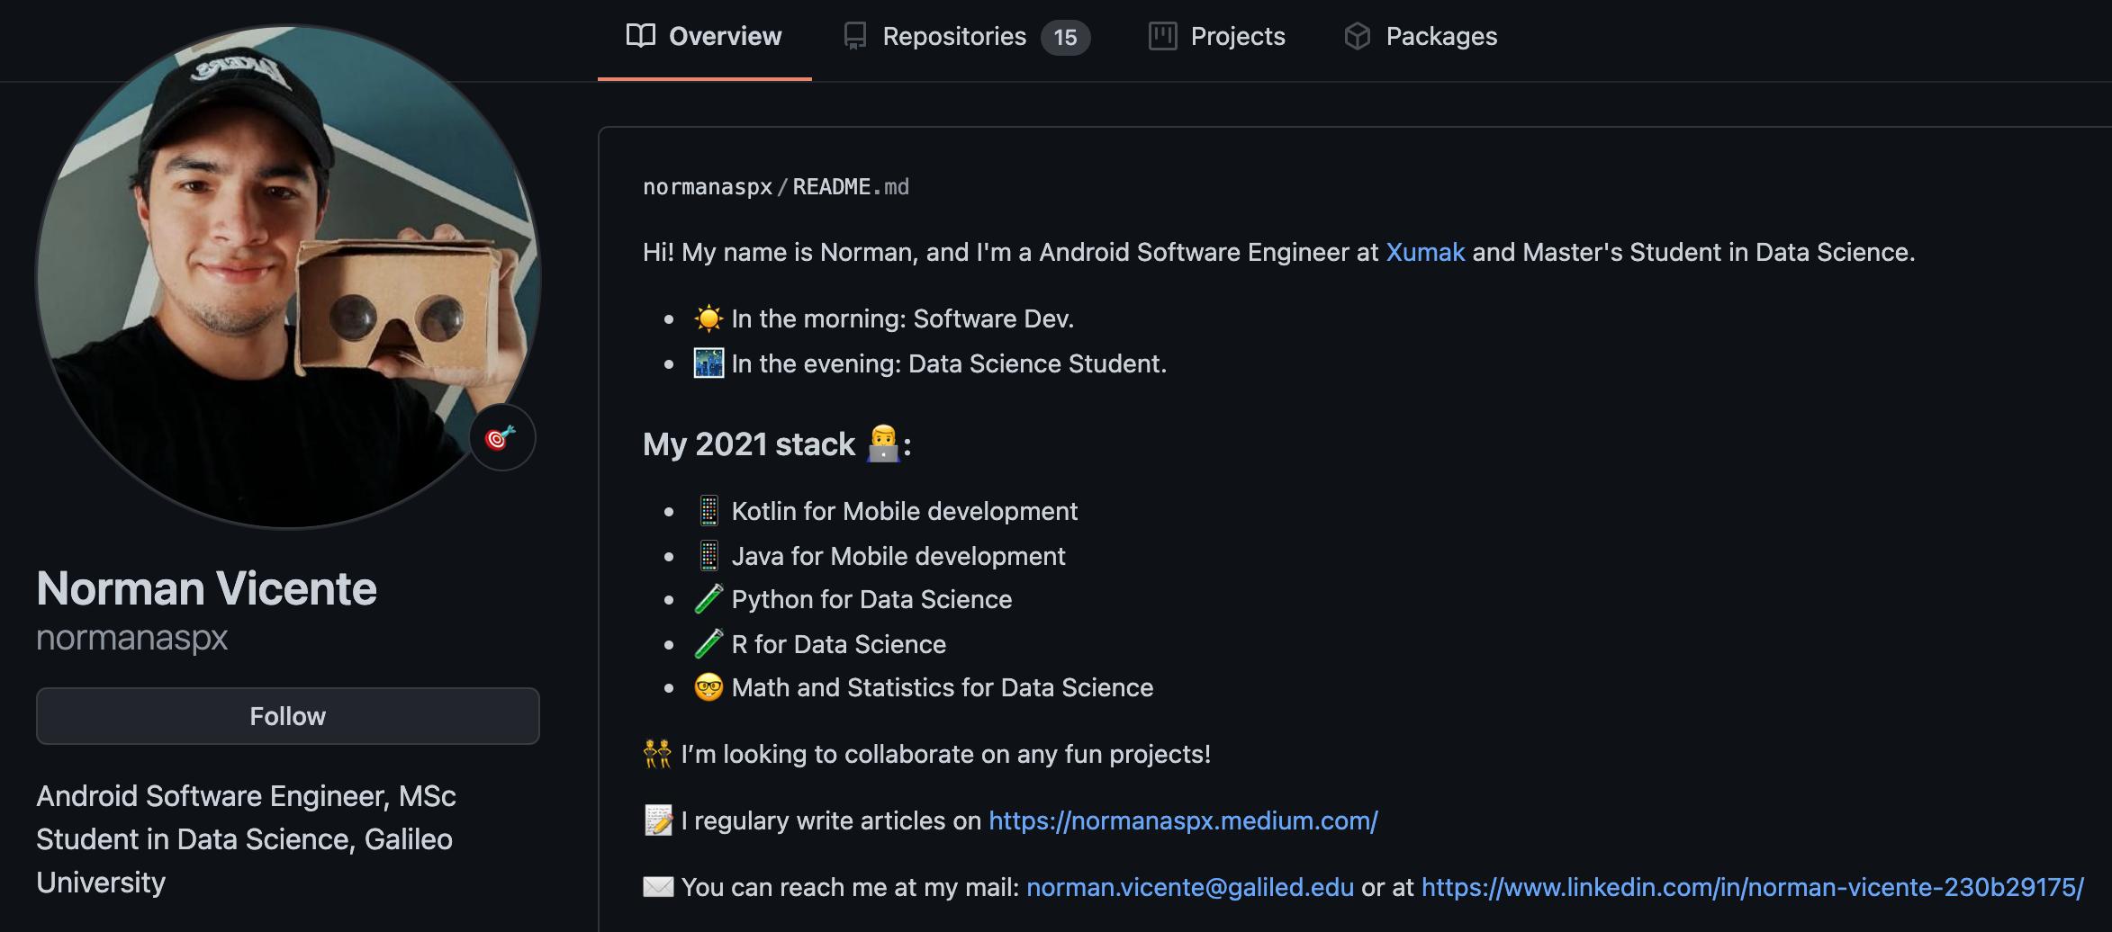
Reach me
LinkedIn: @normanaspx
GitHub: @normanpasx
Facebook: @normanaspx
Medium: @normanaspx
https://normanaspx.github.io/norman/

